Slide 1

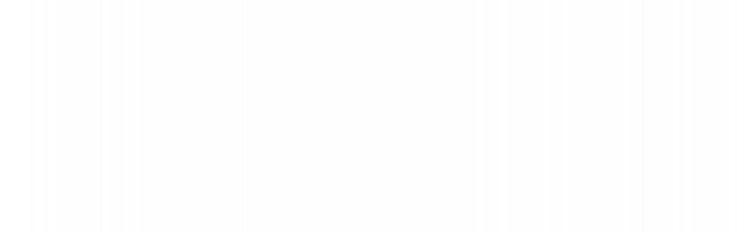

UNIVERSITY INSTITUTE OF ENGINEERING
COMPUTER SCIENCE ENGINEERING
Bachelor of Engineering
Design and Analysis of Algorithms(CST-302/ITT-302)
Prepared By: Amrita Chaudhary (E8745)
Topic: Strassen’s matrix multiplication
DISCOVER . LEARN . EMPOWER

Slide 2
Learning Objectives & Outcomes
Objective:
To understand the concept of Strassen’s matrix multiplication
Outcome:
Student will understand
Strassen’s matrix multiplication

Slide 3
Strassen’s matrix multiplication
Given two square matrices A and B of size n x n each, find their multiplication matrix.
Naive Method
void multiply(int A[ ][N], int B[ ][N], int C[ ][N]) { for (int i = 0; i < N; i++) { for (int j = 0; j < N; j++) { C[i][j] = 0; for (int k = 0; k < N; k++) { C[i][j] += A[i][k]*B[k][j]; } } } }
Time Complexity of above method is O(N³).

Slide 4
Divide and Conquer
Following is simple Divide and Conquer method to multiply two square matrices.
1) Divide matrices A and B in 4 sub-matrices of size N/2 x N/2 as shown in the below diagram.
2) Calculate following values recursively.
ae + bg, af + bh, ce + dg and cf + dh.

Slide 5
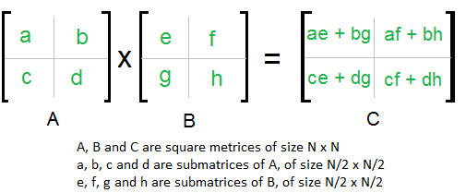
In the above method, we do 8 multiplications for matrices of size N/2 x N/2 and 4 additions. Addition of two matrices takes O(N²) time. So the time complexity can be written as
T(N) = 8T(N/2) + O(N²)
From Master's Theorem, time complexity of above method is O(N³)
which is unfortunately same as the above naive method.

Slide 6
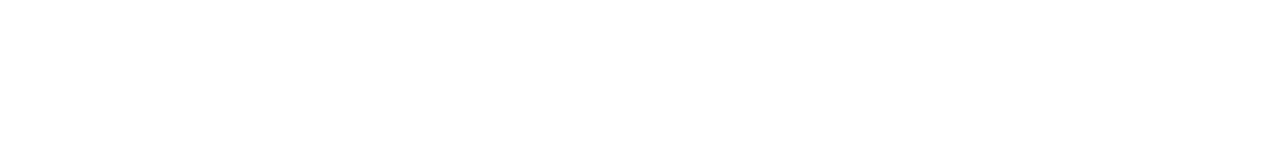
Simple Divide and Conquer also leads to O(N³), can there be a better way?
In the previous divide and conquer method, the main component for high time complexity is 8 recursive calls. The idea of Strassen’s method is to reduce the number of recursive calls to 7.
Strassen’s method is similar to previous simple divide and conquer method in the sense that this method also divide matrices to sub-matrices of size N/2 x N/2 as shown in the above diagram, but in Strassen’s method, the four sub-matrices of result are calculated using following formulae.

Slide 7
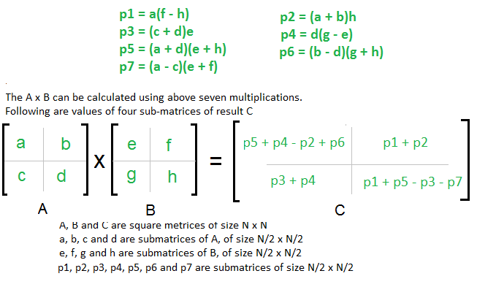
Strassen’s method formula

Slide 8
Time Complexity of Strassen’s Method
Addition and Subtraction of two matrices takes O(N²) time. So time complexity can be written as
T(N) = 7T(N/2) + O(N²)
From Masters Theorem, time complexity of above method is O(N^{Log7}) which is approximately O(N^{2.8074})

Slide 9
NOTE
Generally Strassen’s Method is not preferred for practical applications for following reasons.
1) The constants used in Strassen’s method are high and for a typical application Naive method works better.
2) For Sparse matrices, there are better methods especially designed for them.
3) The submatrices in recursion take extra space.
4) Because of the limited precision of computer arithmetic on non-integer values, larger errors accumulate in Strassen’s algorithm than in Naive Method.

Slide 10
Poll Question
Running time of Strassen's algorithm is better than the naive Theta(n³) method.
True.
False

Slide 11
2) Strassen’s algorithm is a/an_____________ algorithm.
a) Non- recursive
b) Recursive.
c) Approximation
d) Accurate

Slide 12
REFERENCES
Text books:
Cormen, Leiserson, Rivest, Stein, “Introduction to Algorithms”, Prentice Hall of India, 3rd edition 2012. problem, Graph coloring.
Websites:
https://www.geeksforgeeks.org/strassens-matrix-multiplication/

Slide 13
Summary
    Strassen’s matrix multiplication
        Naive Method
        Divide and Conquer
        Strassens’s matrix multiplication.

Slide 14
THANK YOU

